Slide 1
Progress Report: Learning dynamics in a cellular automata model of classroom interaction
clarence Ioakim t. SY
BS4 Applied physics
Adviser: Johnrob y. Bantang
Complexity science group

Slide 2
Motivation:
Model peer-to-peer learning dynamics inside the classroom
Investigate factors affecting the dynamics:
Student aptitude level
Seating arrangement (with respect to student aptitude)
Aptitude homogeneity

Slide 3
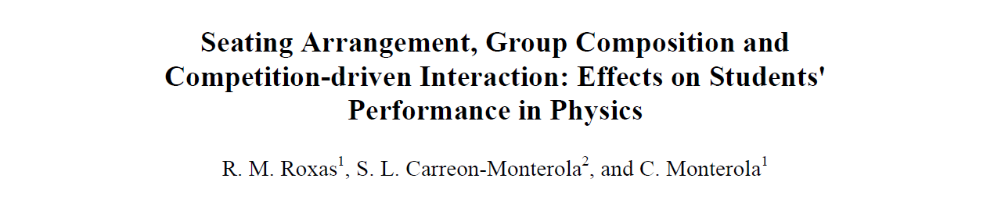
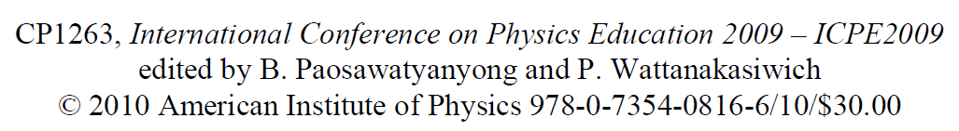
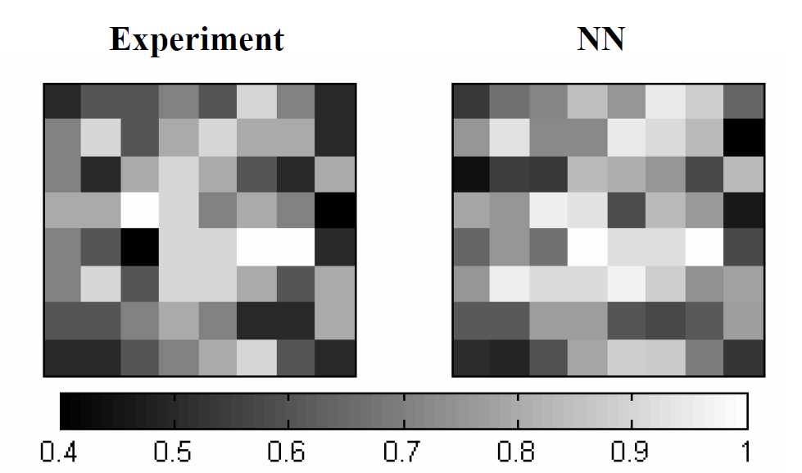
Previous study:
Main findings:
Homogeneity (locally and globally) benefits learning of the classroom
Learning is not solely dependent on how high the aptitude level of the seatmates
Notes:
Uses a neural network to predict the outcome of the classroom based on the initial seating arrangement and aptitude levels of the students
Sixty-eight (68) experimental lectures framed on
Eric Mazur’s Peer Instruction Method [5] were
conducted in 9 learning institutions to investigate the
effect of seating arrangement on students’ learning.
Of these, 20 lectures were done involving college
students and the remaining 48 lectures with high
school students.

Slide 4
Research questions:
Learning rate
How does the number of learned students (binary states) or the class average (continuous states) evolve over time?
Nucleation sites position
How does the position of learned/high scoring students affect the learning rate of the class?
Homogeneity
How does the spatial aptitude homogeneity affect the learning rate of the class?
How does the social aspect affect the classroom (Watts–Strogatz model) dynamics

Slide 5
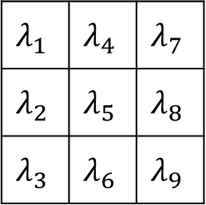

2D Binary Probabilistic CA Model
Learning probability
$$P_{i}=1−\prod_{N}{(1−S_{i}λ_{i})}$$
$$λ_{1}$$ | $$λ_{4}$$ | $$λ_{7}$$
$$λ_{2}$$ | $$λ_{5}$$ | $$λ_{8}$$
$$λ_{3}$$ | $$λ_{6}$$ | $$λ_{9}$$
Notes:
Each student belongs to a 3x3 neighborhood $N$ (Moore neighborhood) with a $λ_{i}$ chance from learning from their neighbors $n_{i}$ with state $S_{i}$
Note: student of interest is set to be the center of the neighborhood ($n_{5}$)

Slide 6
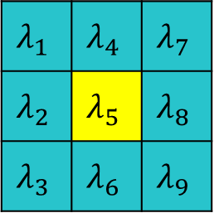

2D Binary Probabilistic CA Model
1 | 9 | 17
2 | 10 | 18
3 | 11 | 19
4 | 12
5 | 13
6 | 14 |  |  |  |  |  | 62
7 | 15 |  |  |  |  |  | 63
8 | 16 |  |  |  |  |  | 64
$$λ_{1}$$ | $$λ_{4}$$ | $$λ_{7}$$
$$λ_{2}$$ | $$λ_{5}$$ | $$λ_{8}$$
$$λ_{3}$$ | $$λ_{6}$$ | $$λ_{9}$$
Learning probability
$$P_{i}=1−\prod_{N}{(1−S_{i}λ_{i})}$$
Classroom
Notes:
Each student belongs to a 3x3 neighborhood $N$ (Moore neighborhood) with a $λ_{i}$ chance from learning from their neighbors $n_{i}$ with state $S_{i}$
Note: student of interest is set to be the center of the neighborhood ($n_{5}$)

Slide 7
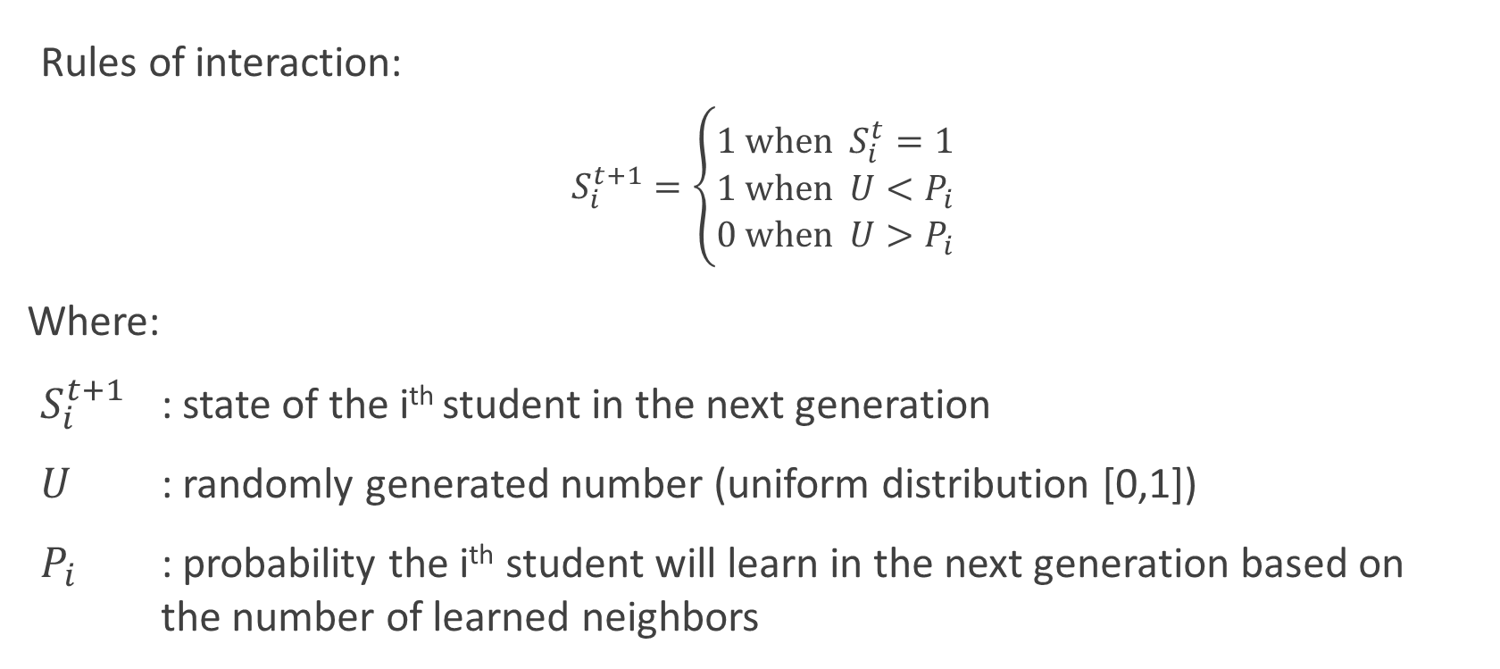
2D Binary Probabilistic CA Model
Rules of interaction:
$$S_{i}^{t+1}=\left\{\begin{aligned}1 \text{when} S_{i}^{t}=1 \\ 1 \text{when} U<P_{i} \\ 0 \text{when} U>P_{i}\end{aligned}\right.$$
Where:
$S_{i}^{t+1}$ : state of the i^{th} student in the next generation
$U$ : randomly generated number (uniform distribution [0,1])
$P_{i}$ : probability the i^{th} student will learn in the next generation based on the number of learned neighbors

Slide 8
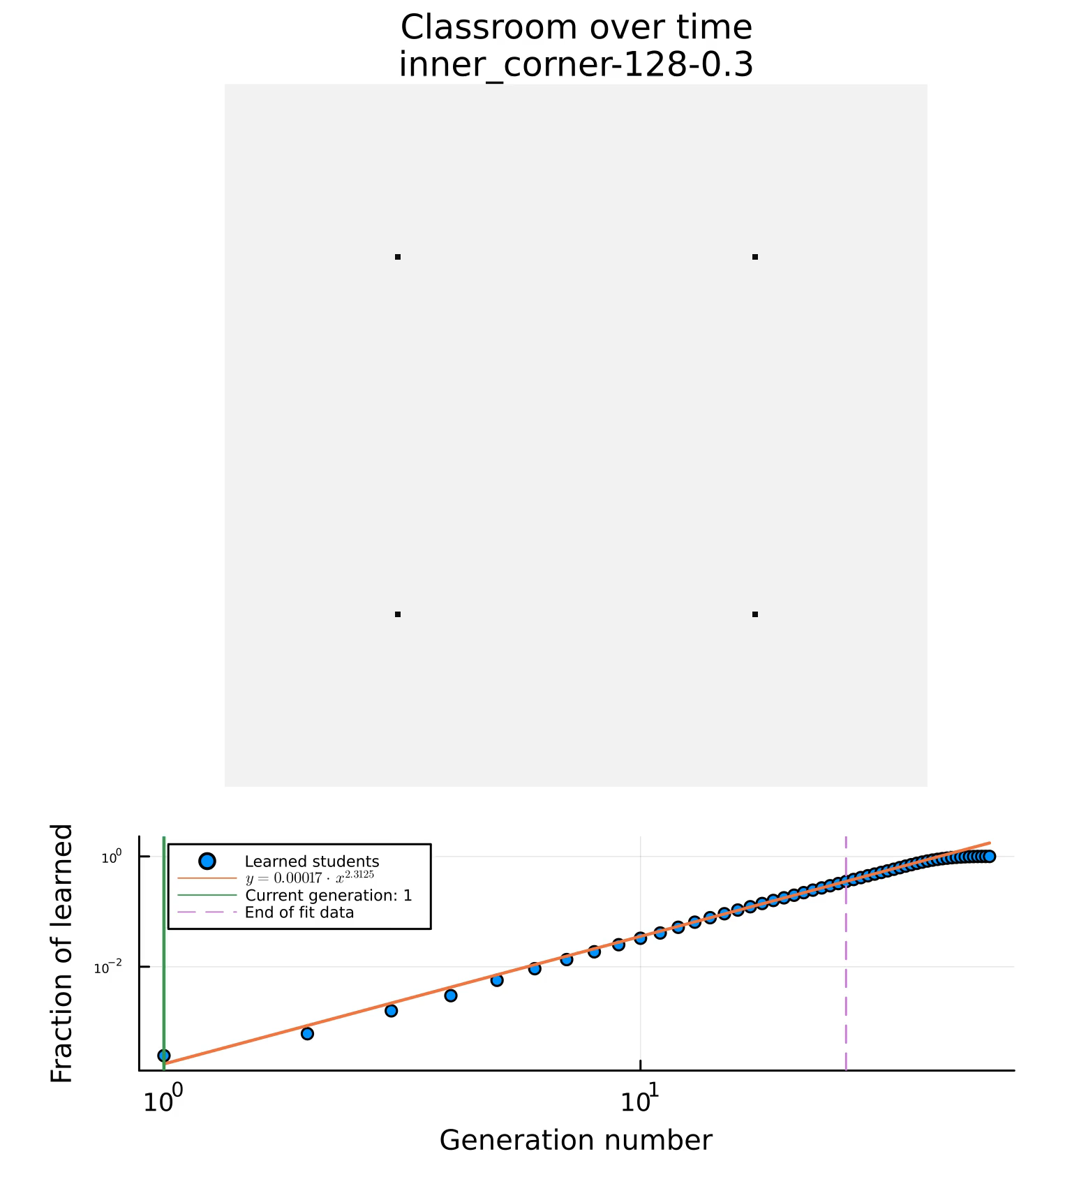
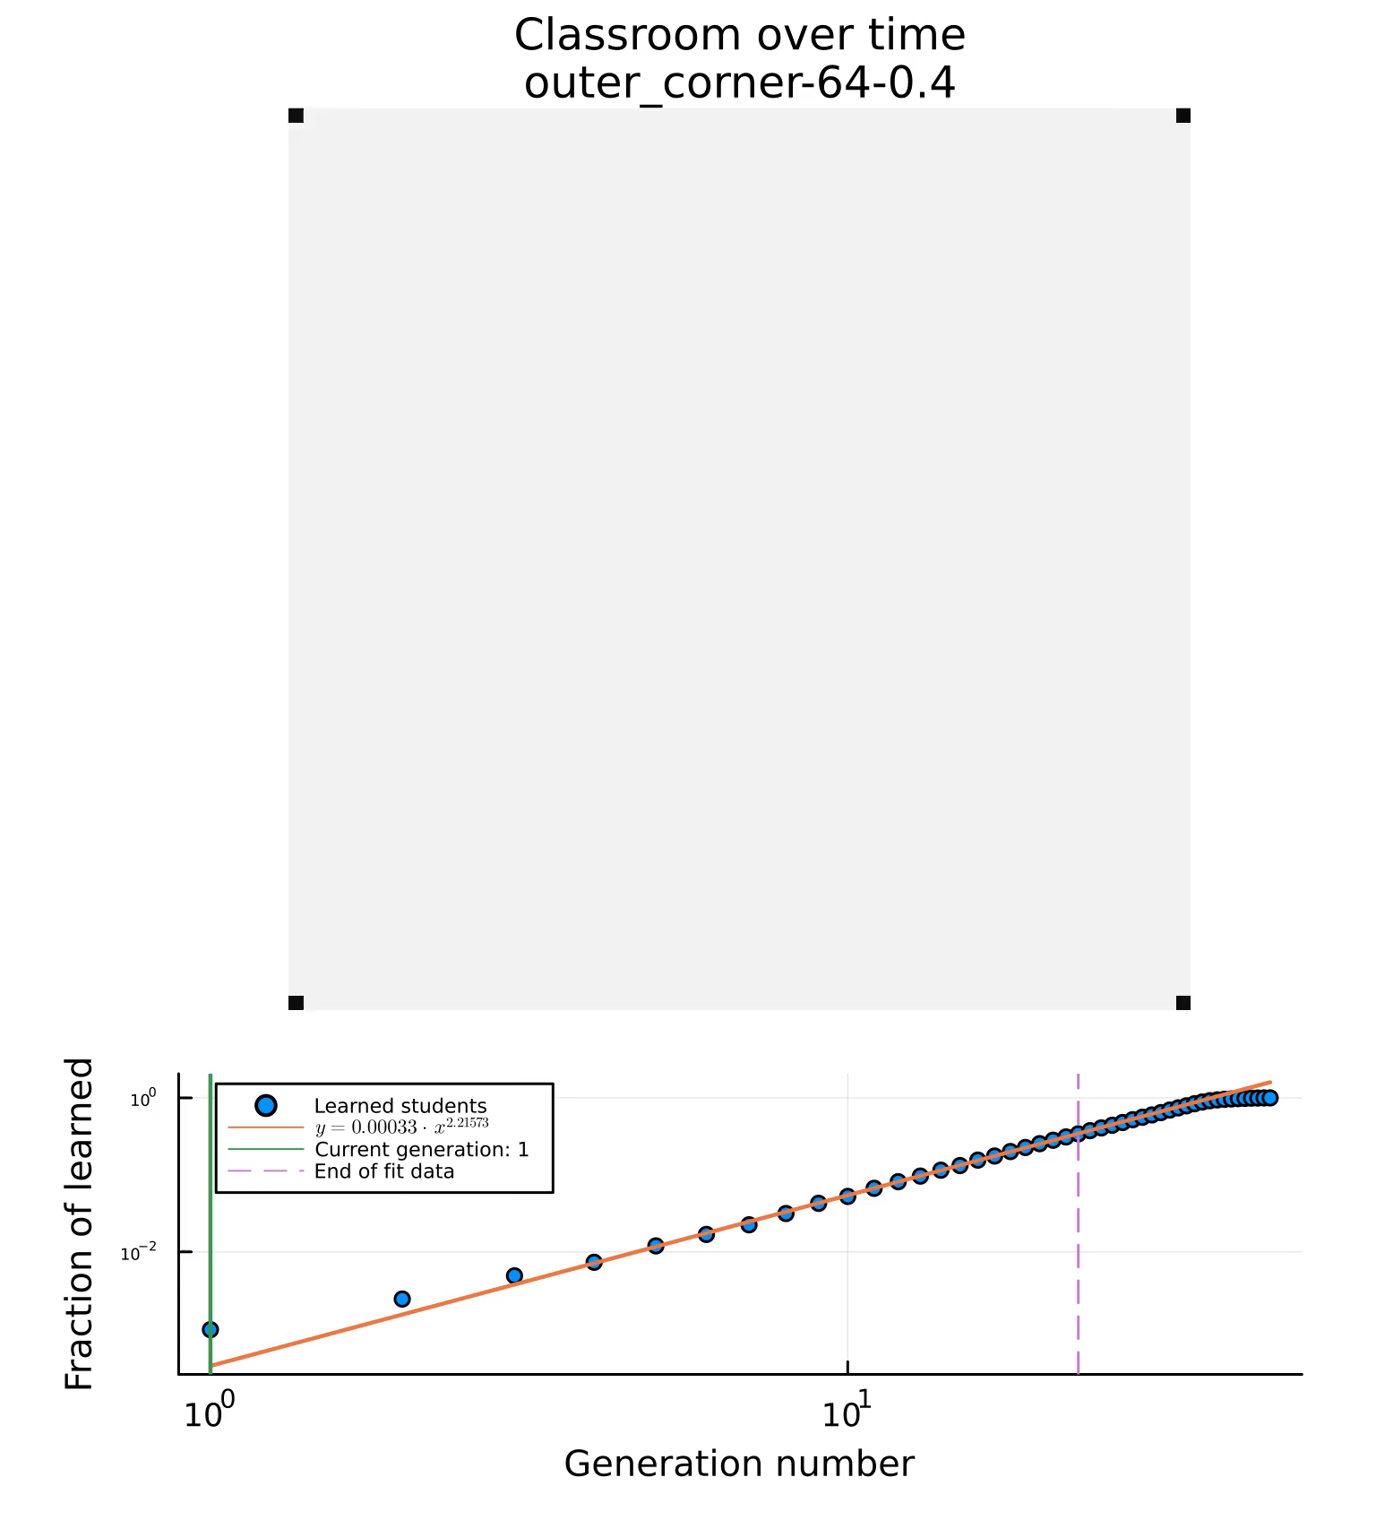
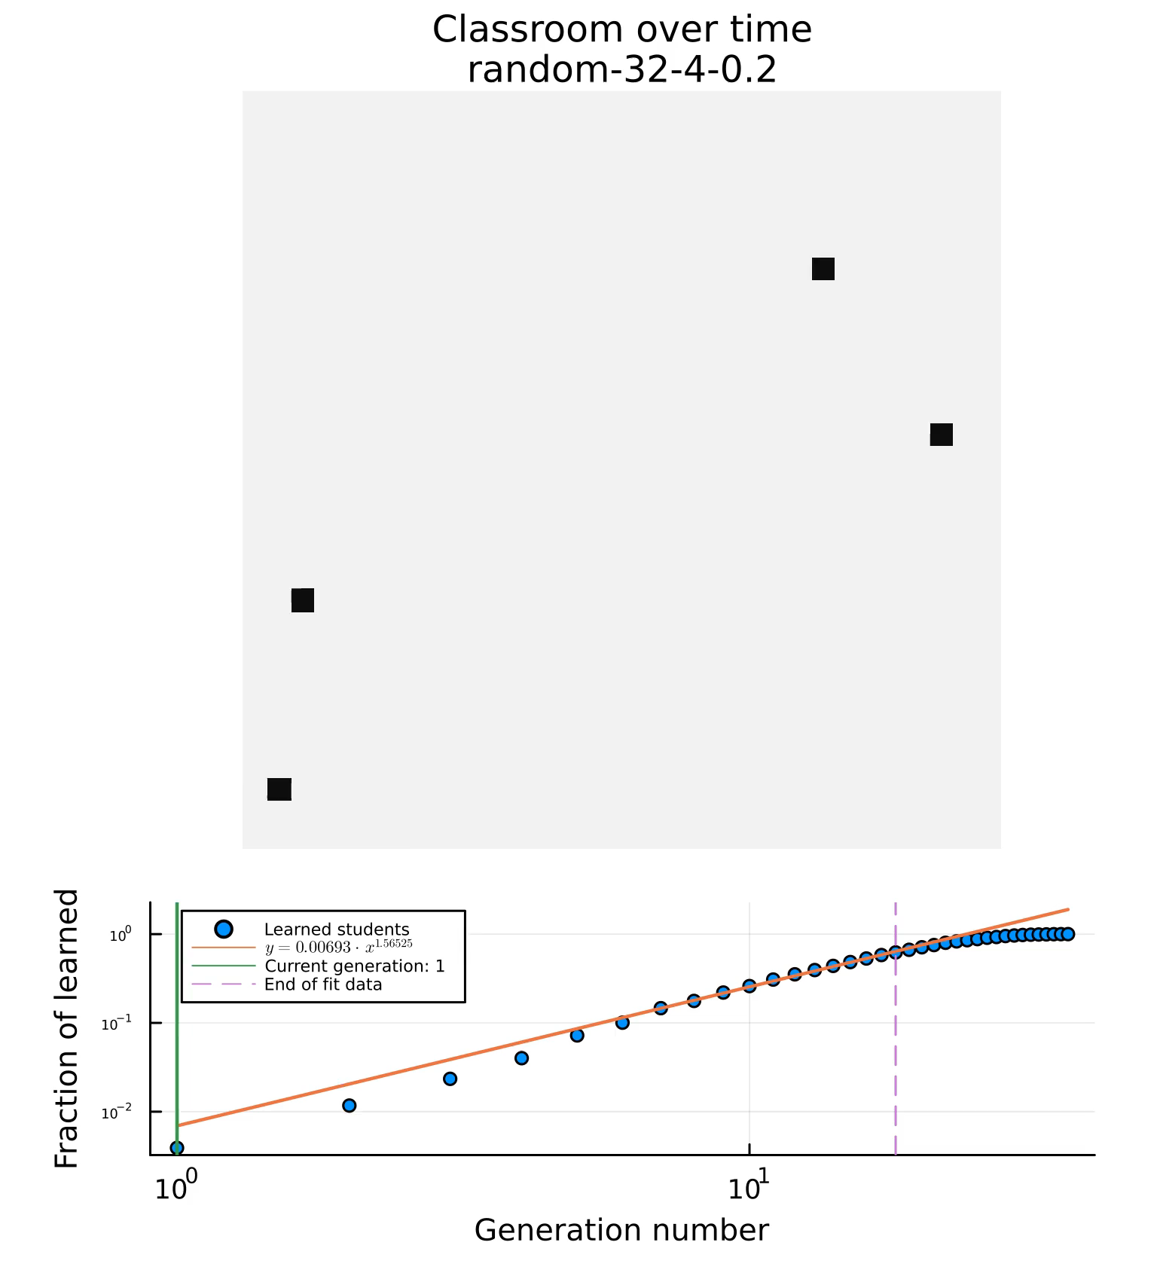
2D Binary Probabilistic Cellular Automata Model
Notes:
Parameters we get from each simulation:
Number of generations to saturate the class (normalized to the number of students in the class): learned/max
Characteristic variable (m). Taken as the exponent of the fitted line y=ax^b
The fitting of the data ends at 50%, so that the it only measures the spreading before the finite size effects kicks in

Slide 9
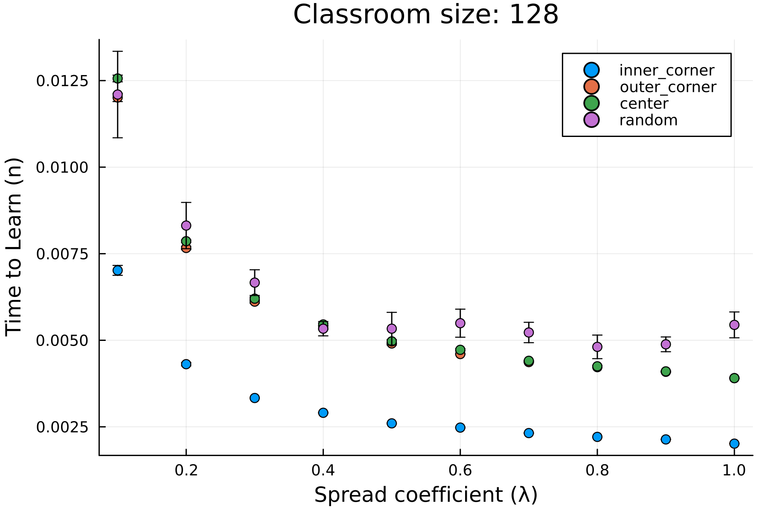
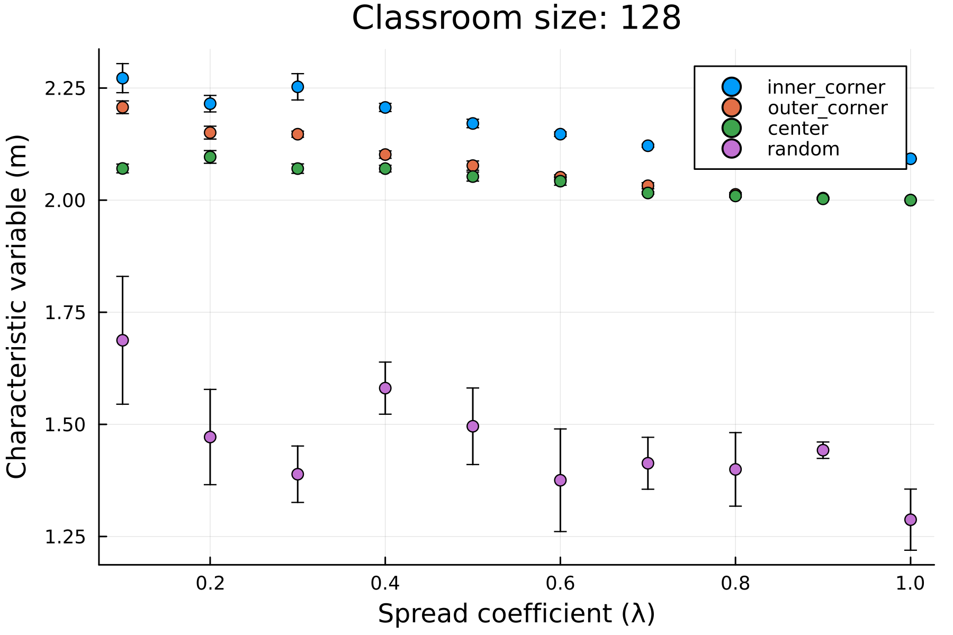

2D Binary Probabilistic Cellular Automata Model
Plots for:
Spread coefficient ($λ$) vs Characteristic variable (m)
Spread coefficient ($λ$) vs time to learn (n)
Notes:
Errorbars: from 5 independent runs, we take the mean to be the best estimate, and the standard deviation of means (std(params)/length(params)) to be the error

Slide 10
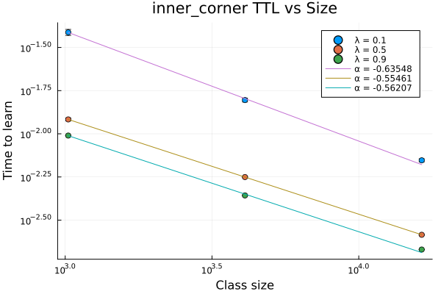
2D Binary Probabilistic Cellular Automata Model
Plots for:
Time to learn vs Class size
Notes:
Errorbars: from 5 independent runs, we take the mean to be the best estimate, and the standard deviation of means (std(params)/length(params)) to be the error

Slide 11
To do:
Introduce orientation bias in the system (anisotropic system)
Introduce inhomogeneous individual learning rate
Model the benefit of local/neighborhood homogeneity
Introduce memory or unlearning to the system
Adjust model to accommodate continuous student states
Fit model parameters to existing data

Slide 12
Progress Report: Learning dynamics in a cellular automata model of classroom interaction
clarence Ioakim t. SY
BS4 Applied physics
Adviser: Johnrob y. Bantang
Complexity science group

